Slide 1
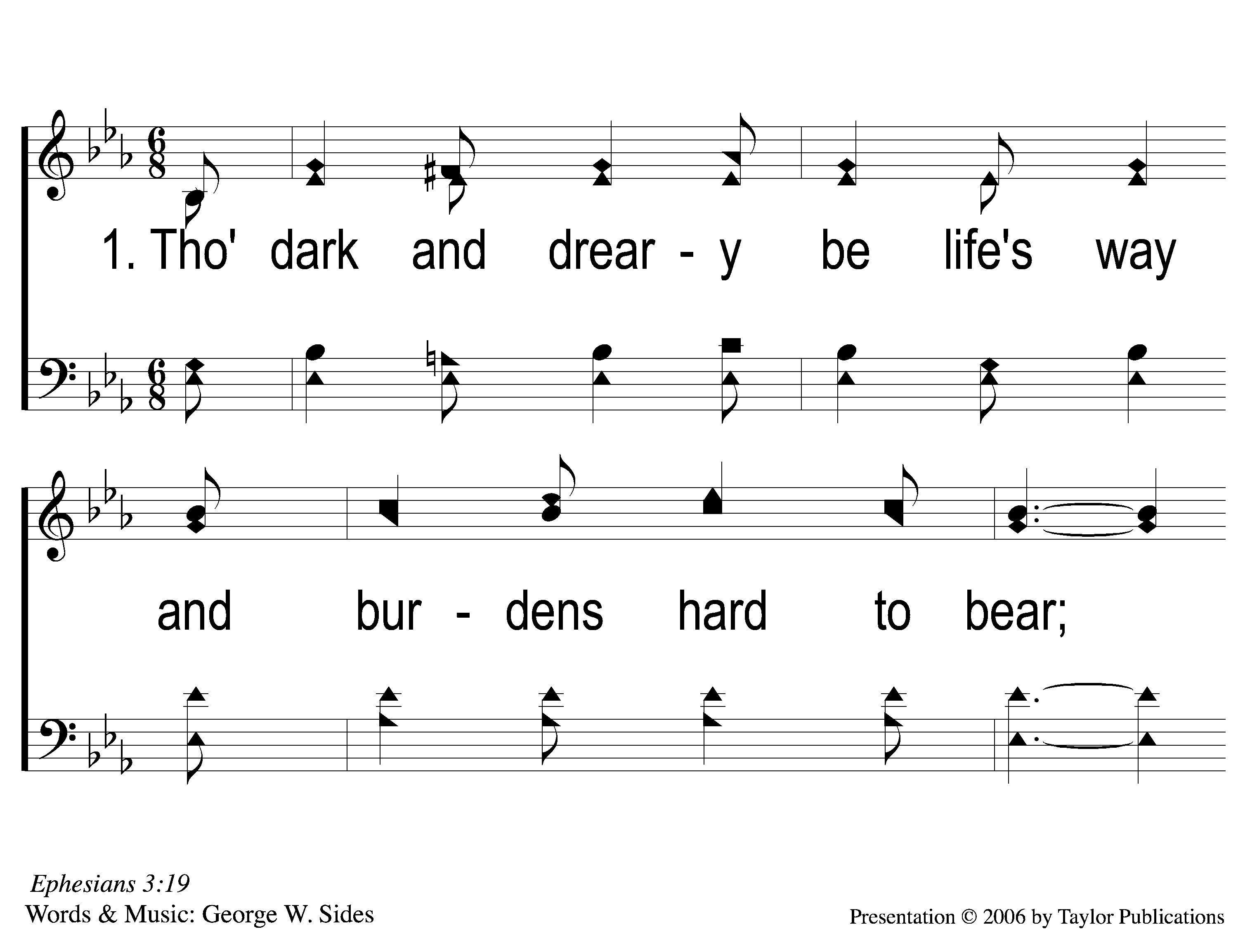
1-1 Christ’s Love Is All I Need
Christ’s Love Is All I Need
65

Slide 2
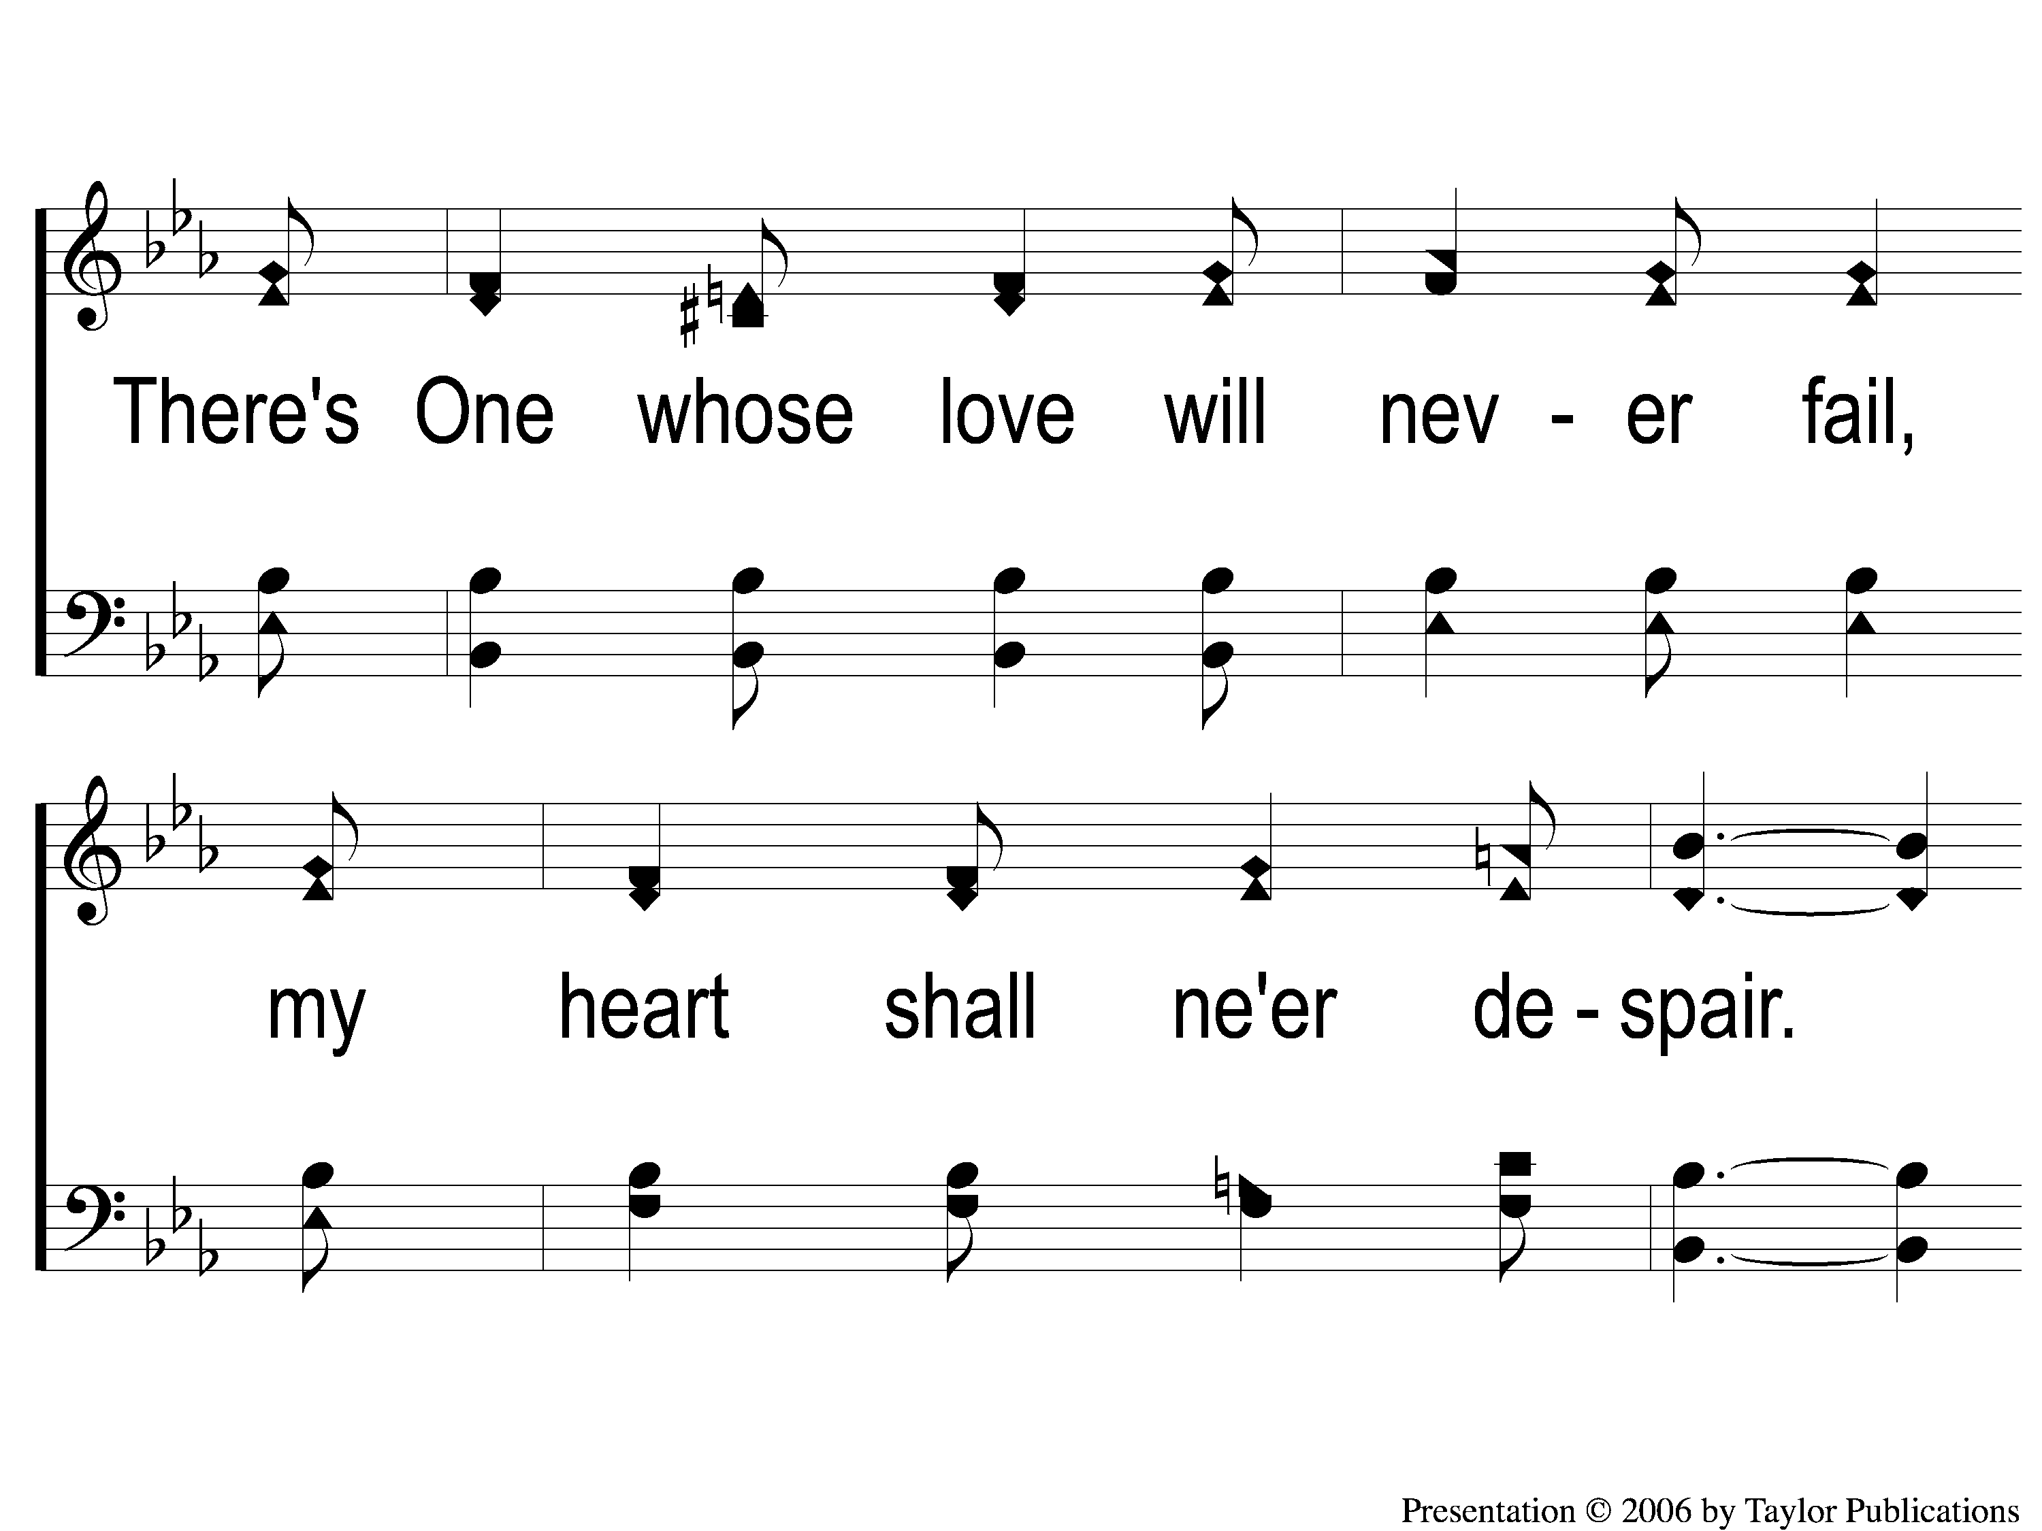
1-2 Christ’s Love Is All I Need
Christ’s Love Is All I Need
65

Slide 3
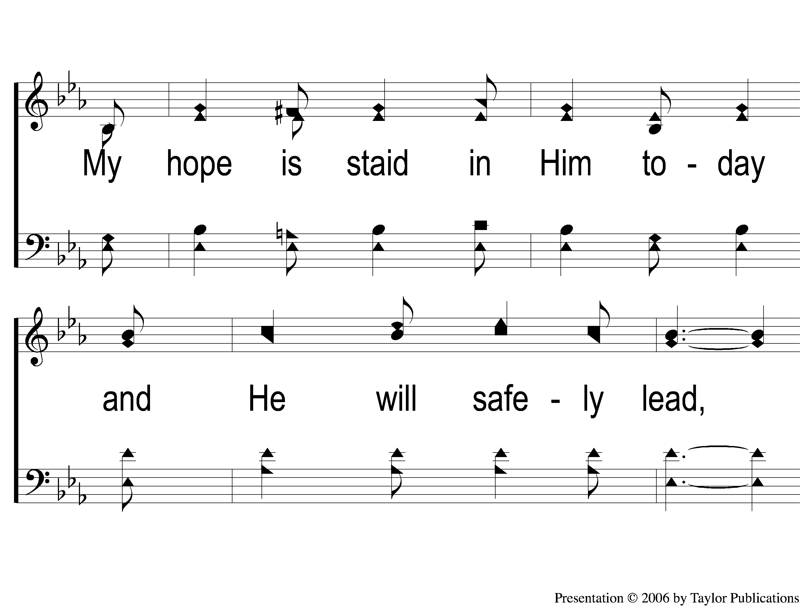
1-3 Christ’s Love Is All I Need
Christ’s Love Is All I Need
65

Slide 4
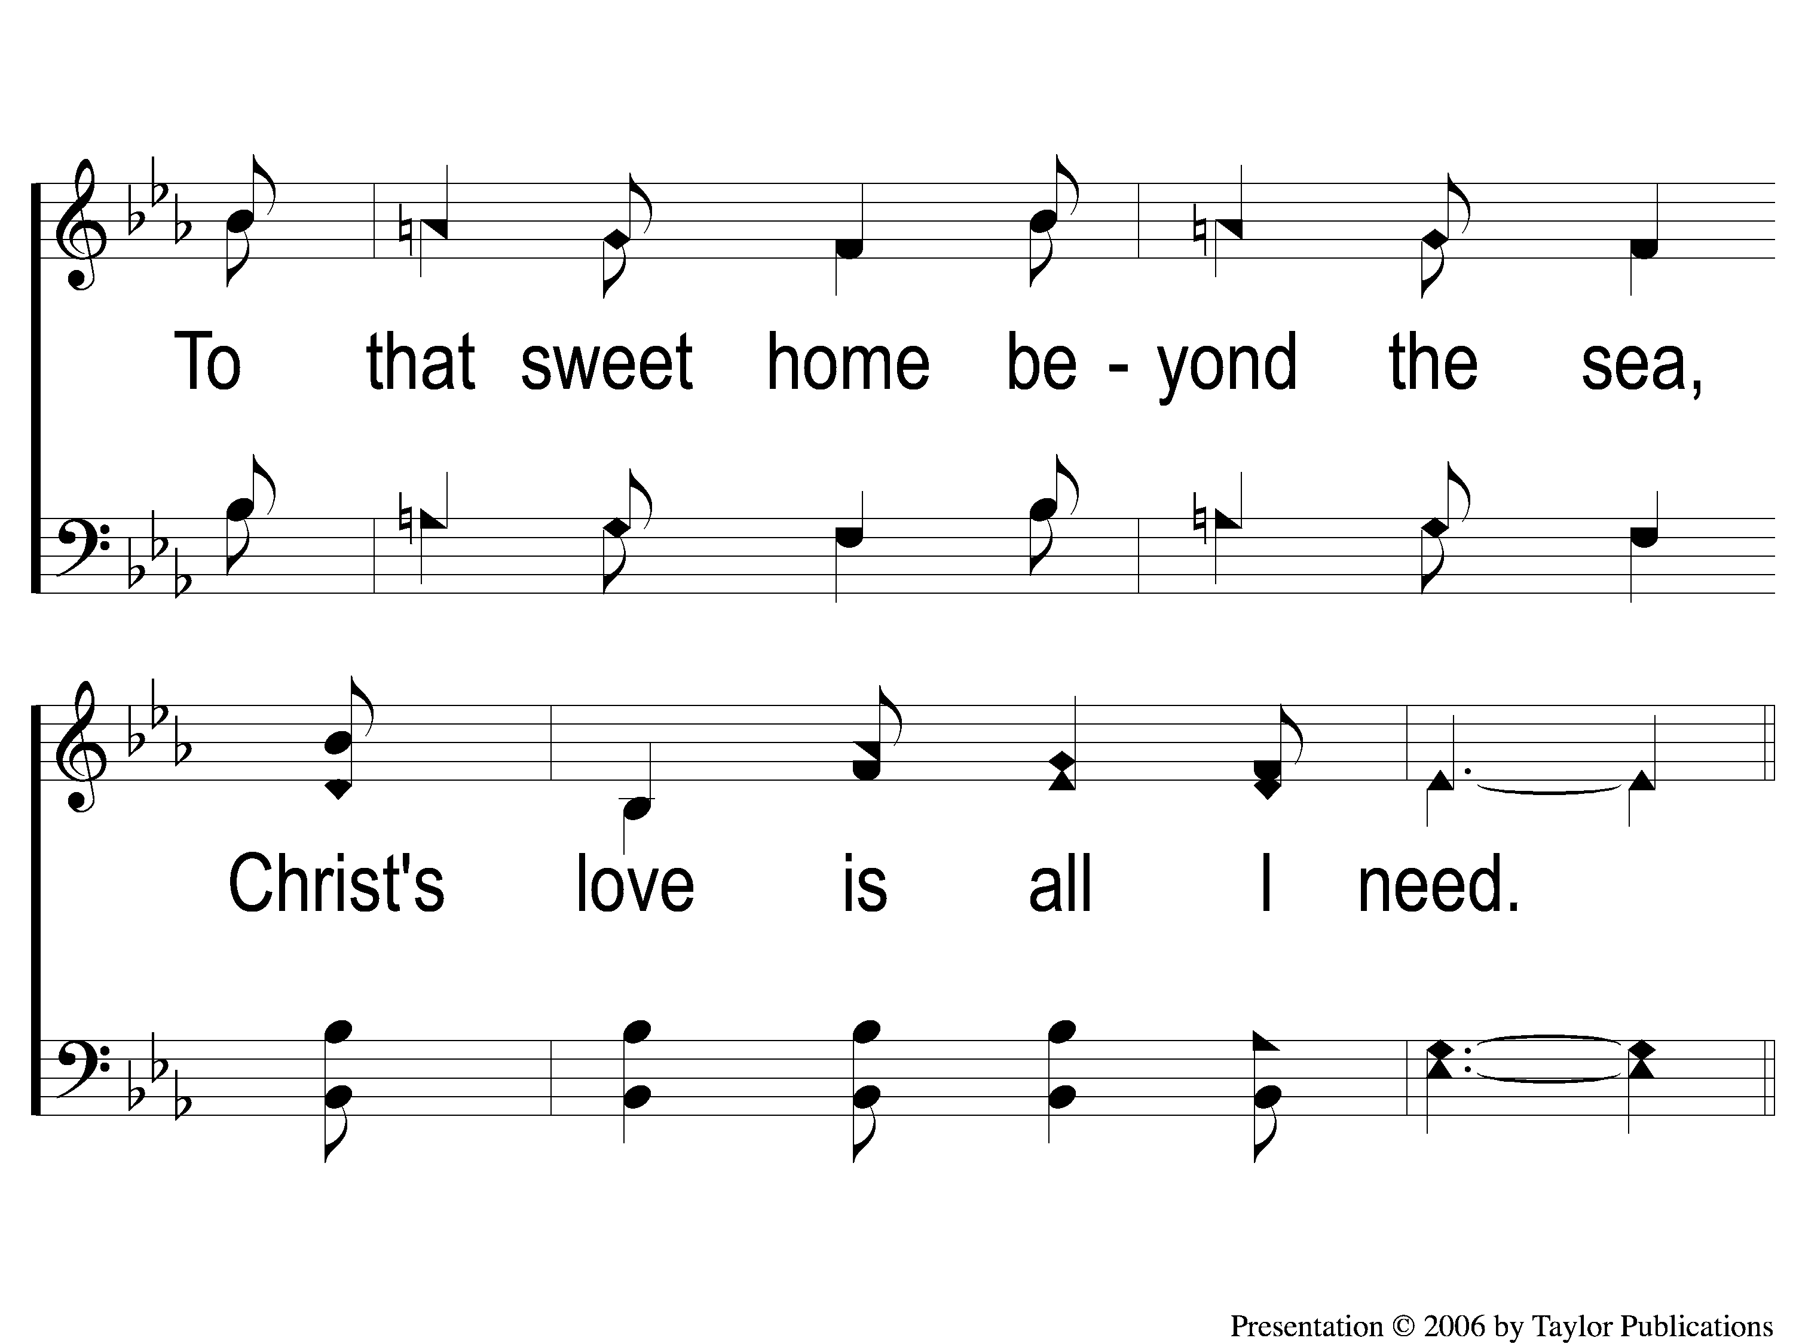
1-4 Christ’s Love Is All I Need
Christ’s Love Is All I Need
65

Slide 5
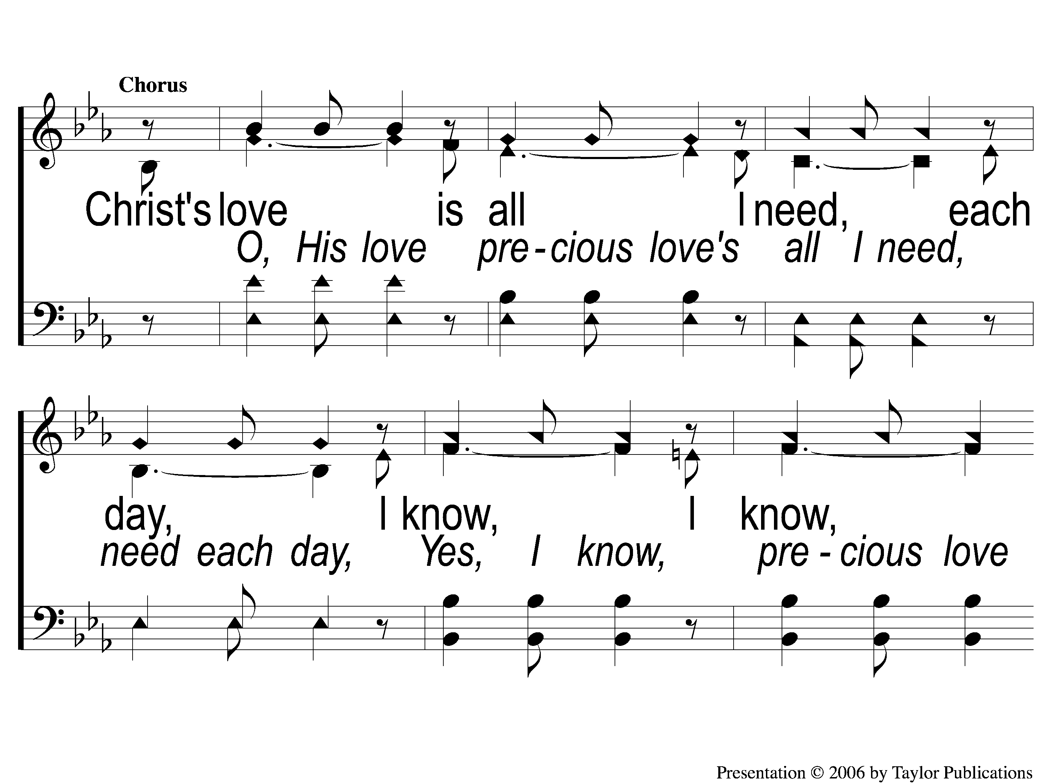
C-1 Christ’s Love Is All I Need
Christ’s Love Is All I Need
65

Slide 6
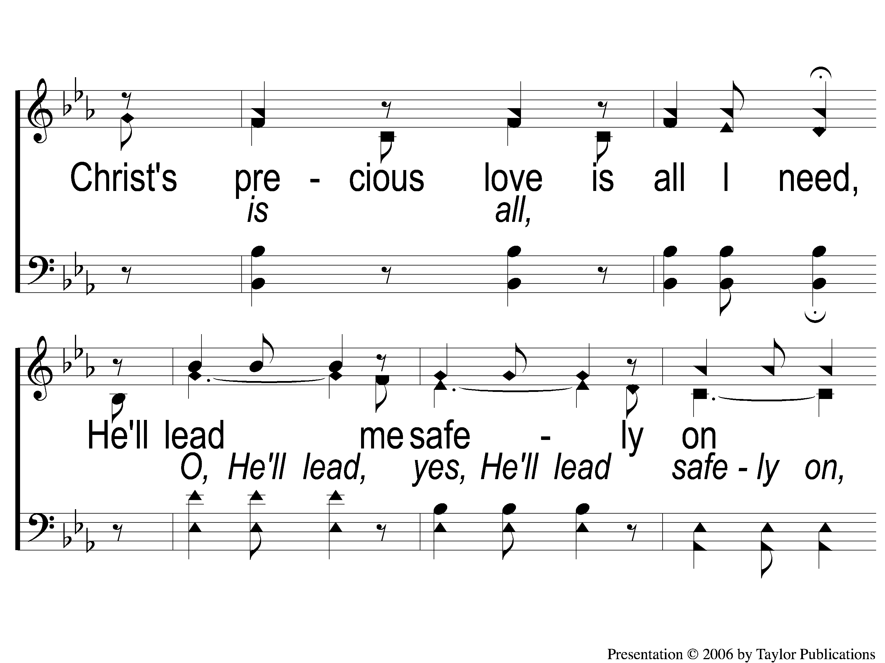
C-2 Christ’s Love Is All I Need
Christ’s Love Is All I Need
65

Slide 7
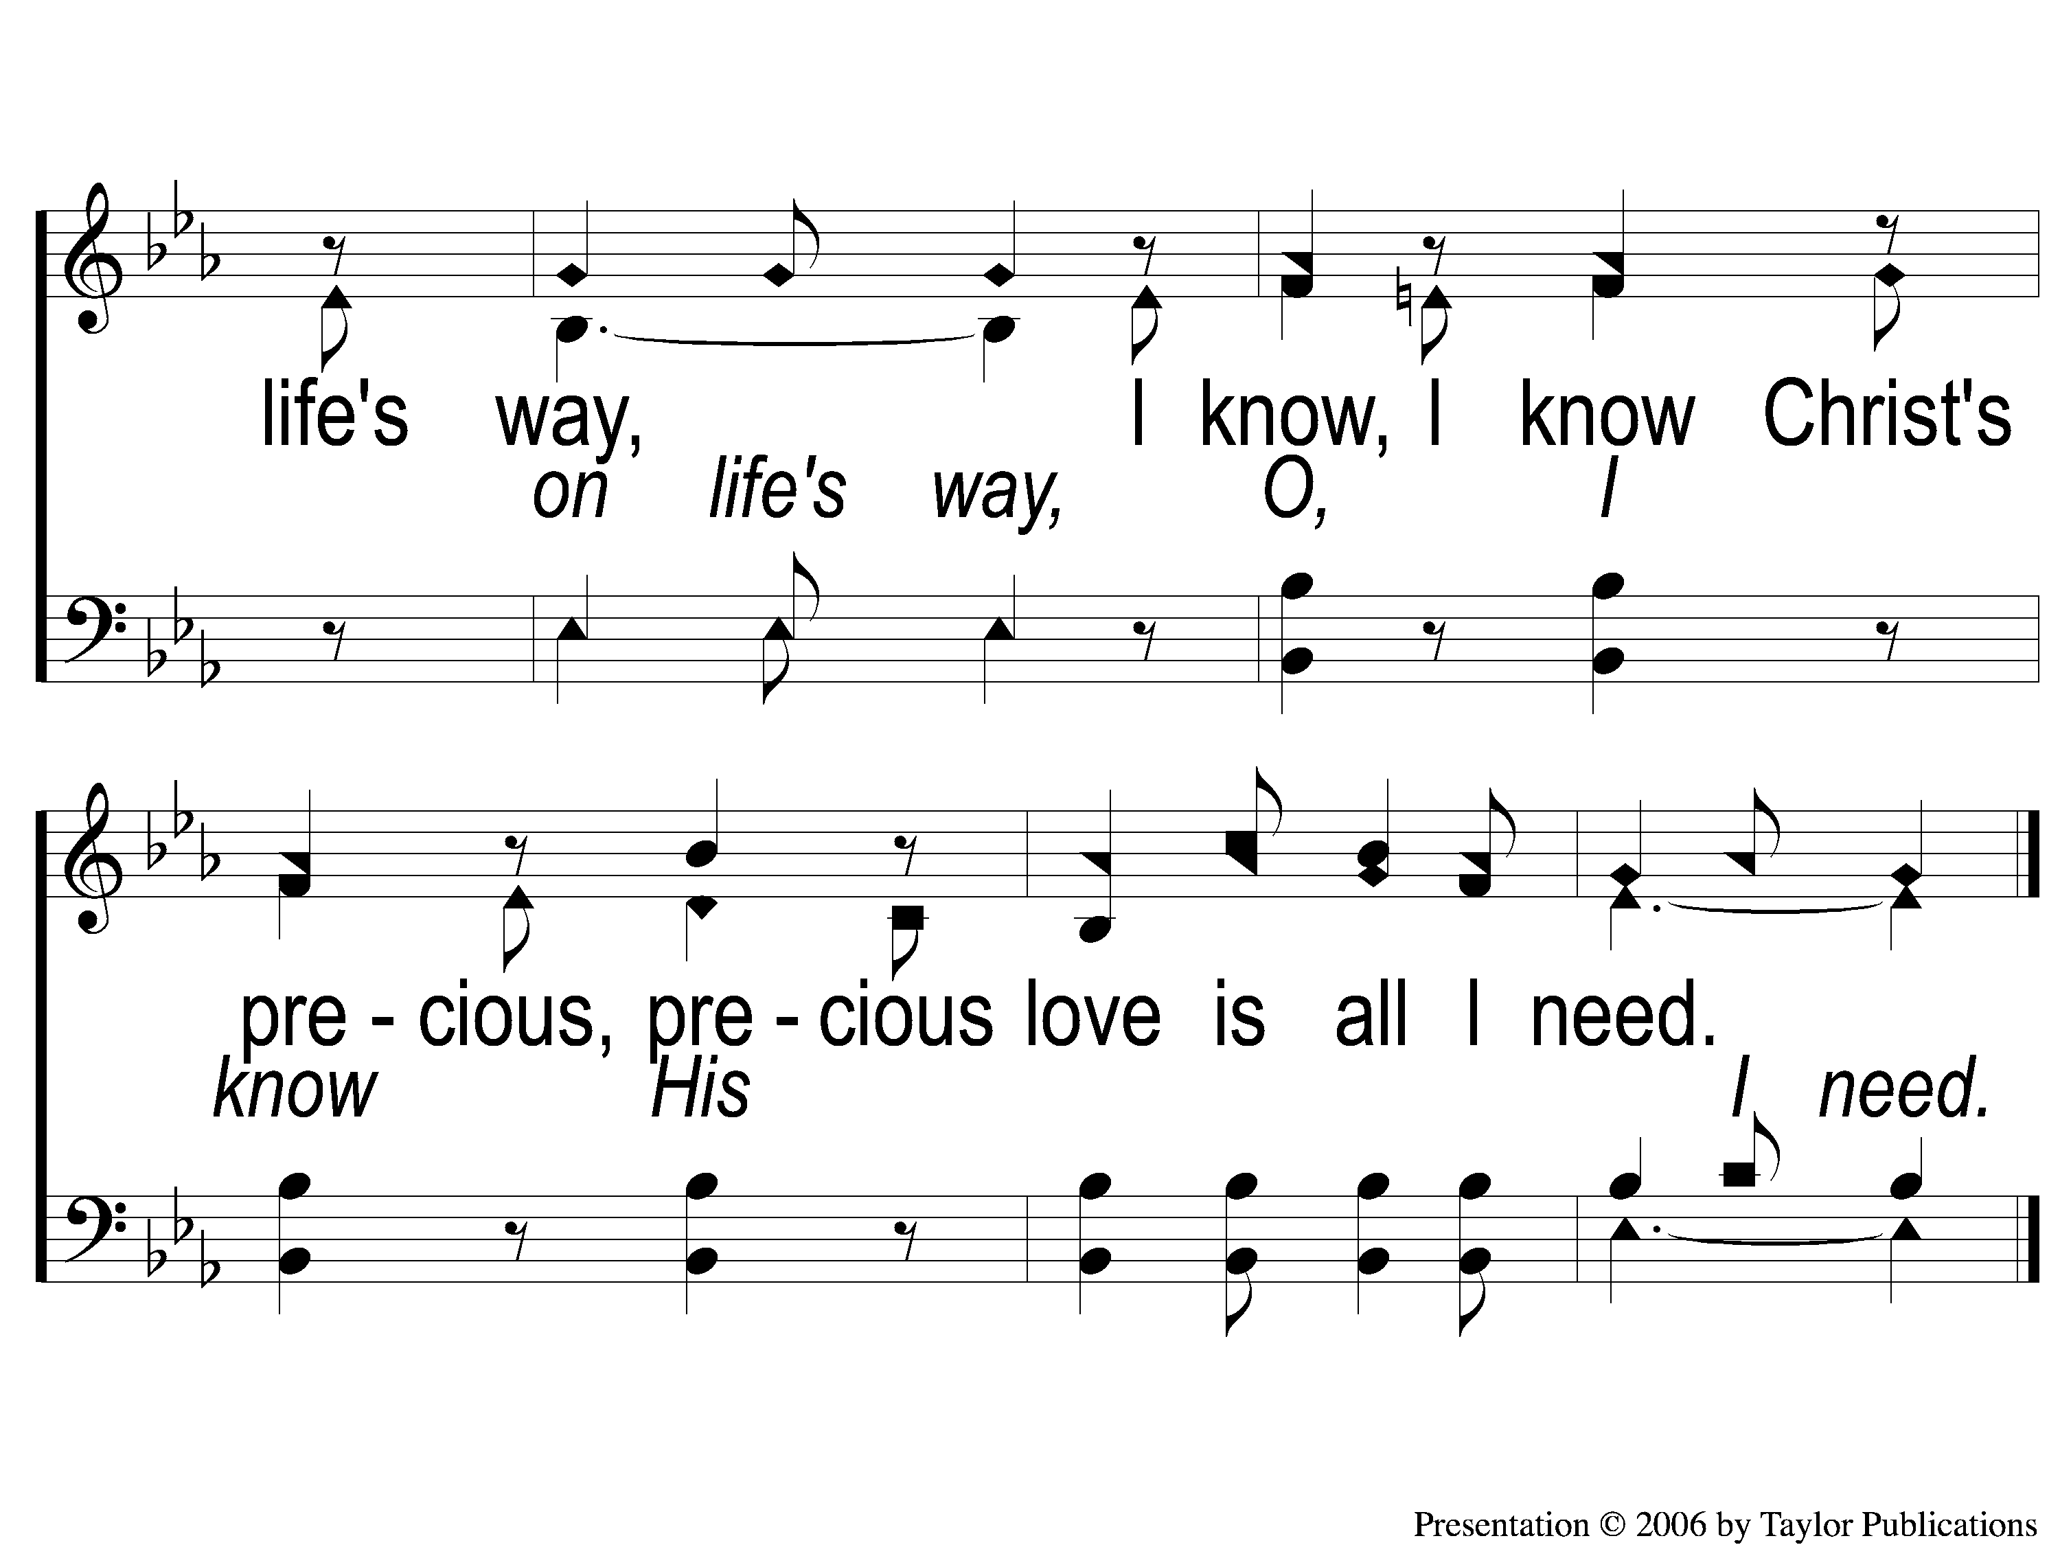
C-3 Christ’s Love Is All I Need
Christ’s Love Is All I Need
65

Slide 8
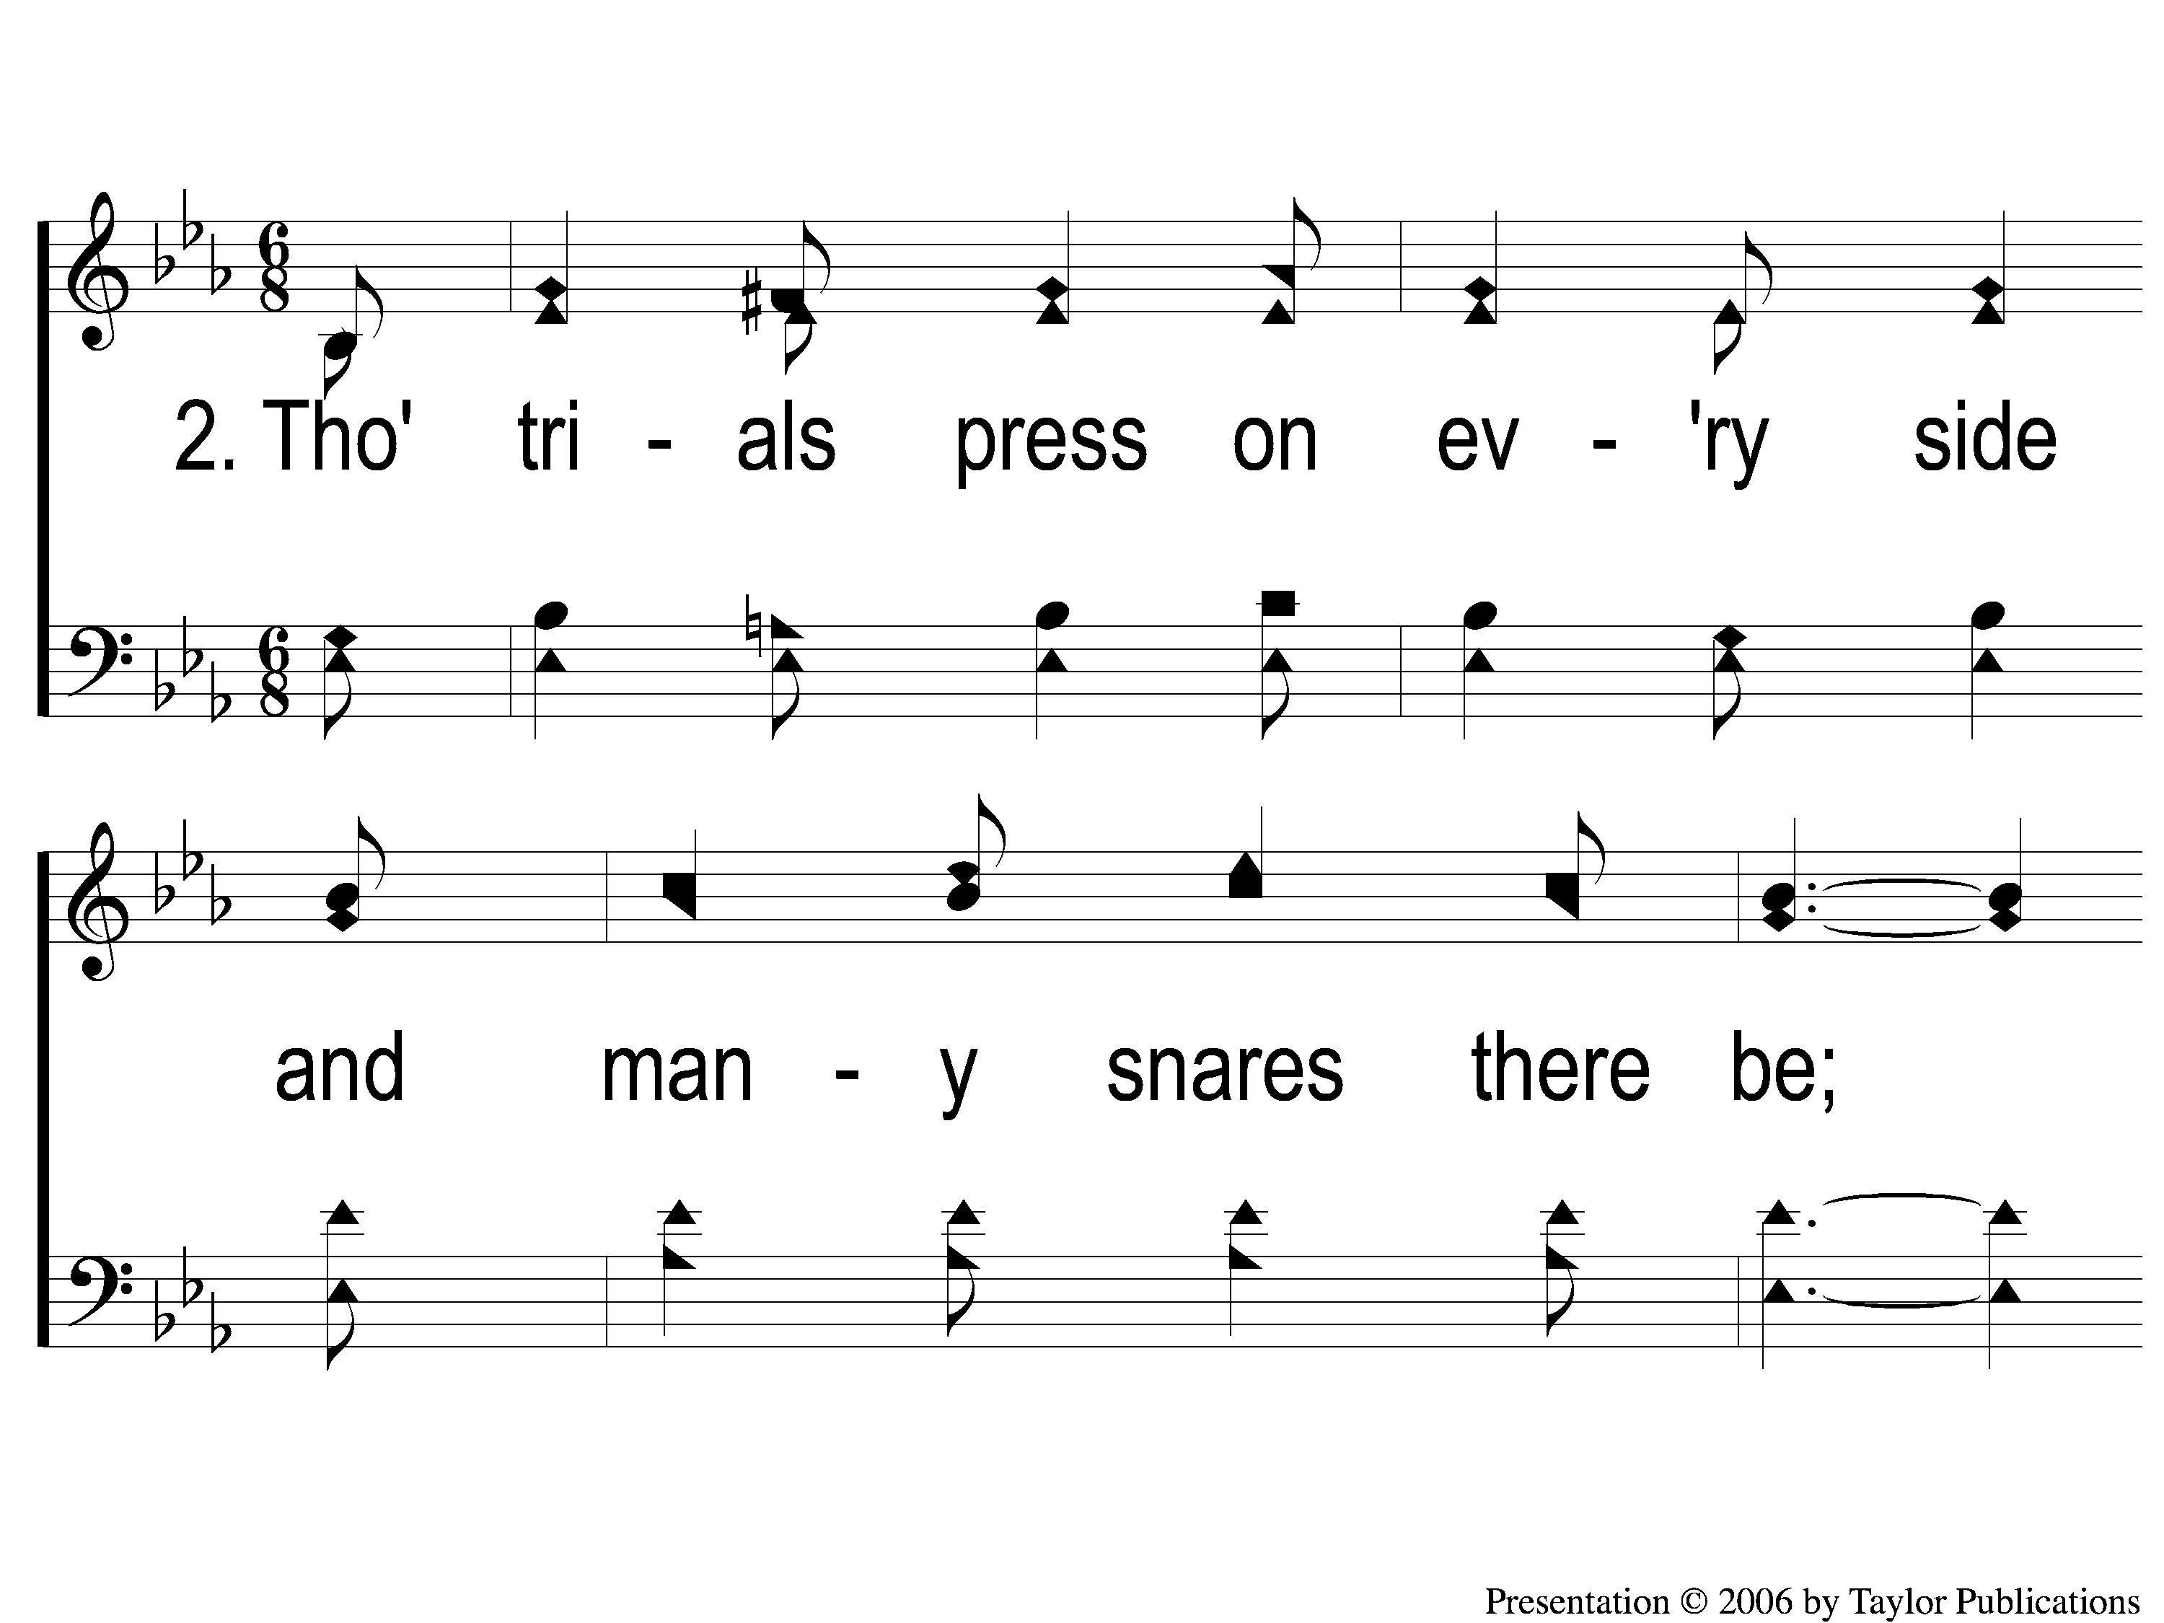
2-1 Christ’s Love Is All I Need
Christ’s Love Is All I Need
65

Slide 9
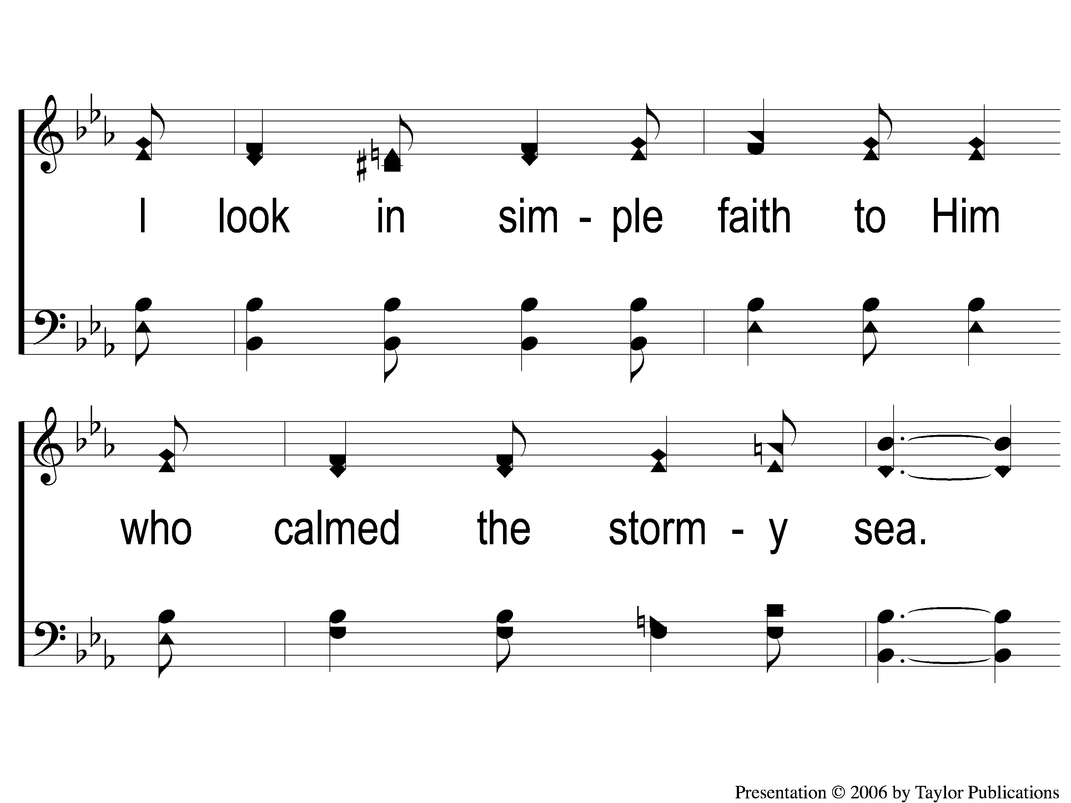
2-2 Christ’s Love Is All I Need
Christ’s Love Is All I Need
65

Slide 10
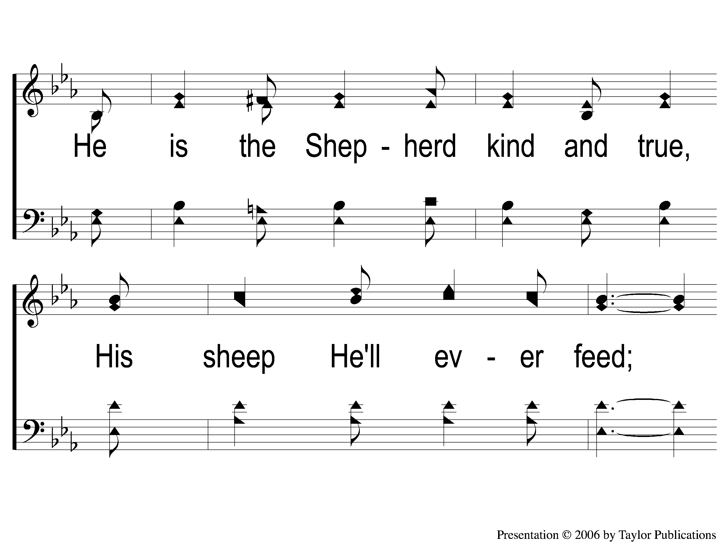
2-3 Christ’s Love Is All I Need
Christ’s Love Is All I Need
65

Slide 11
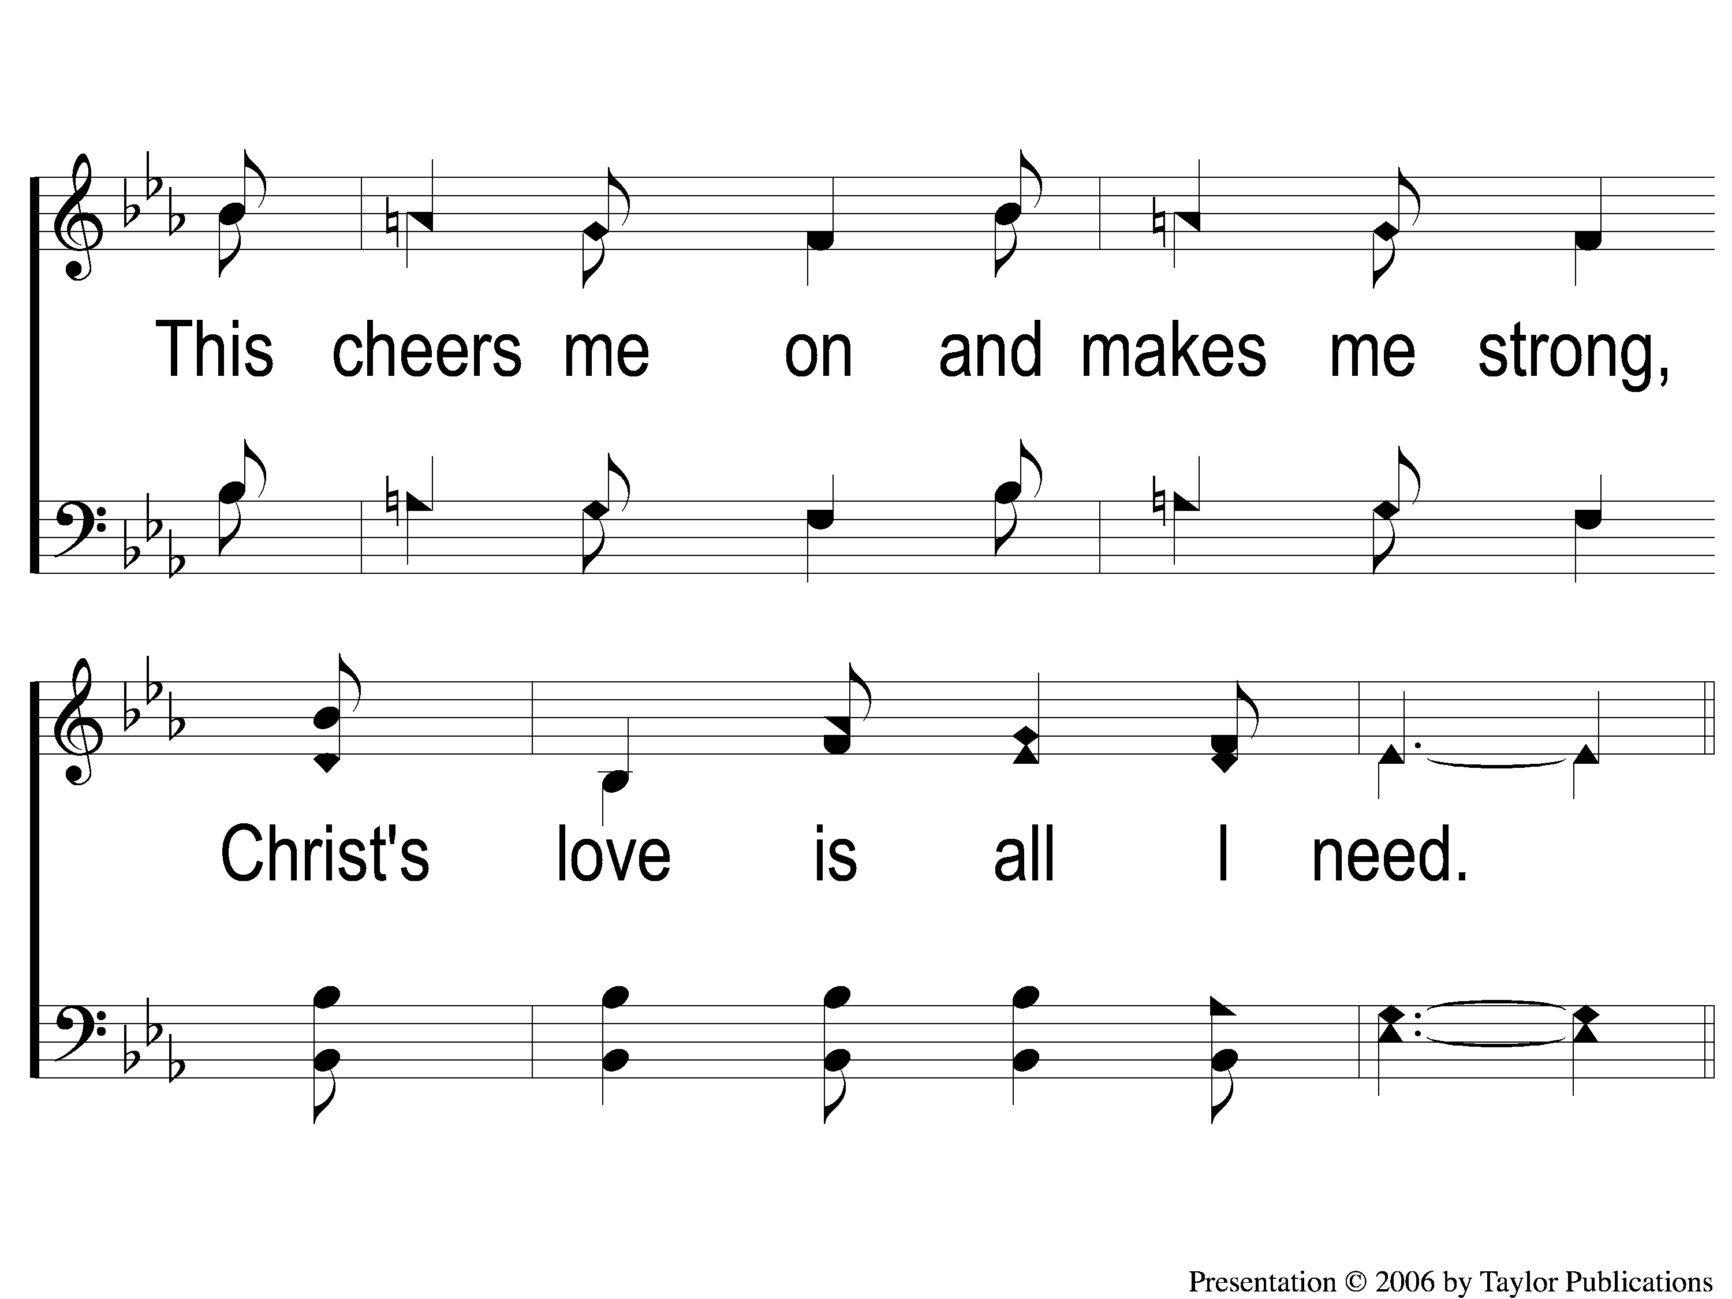
2-4 Christ’s Love Is All I Need
Christ’s Love Is All I Need
65

Slide 12
C-1 Christ’s Love Is All I Need
Christ’s Love Is All I Need
65

Slide 13
C-2 Christ’s Love Is All I Need
Christ’s Love Is All I Need
65

Slide 14
C-3 Christ’s Love Is All I Need
Christ’s Love Is All I Need
65

Slide 15
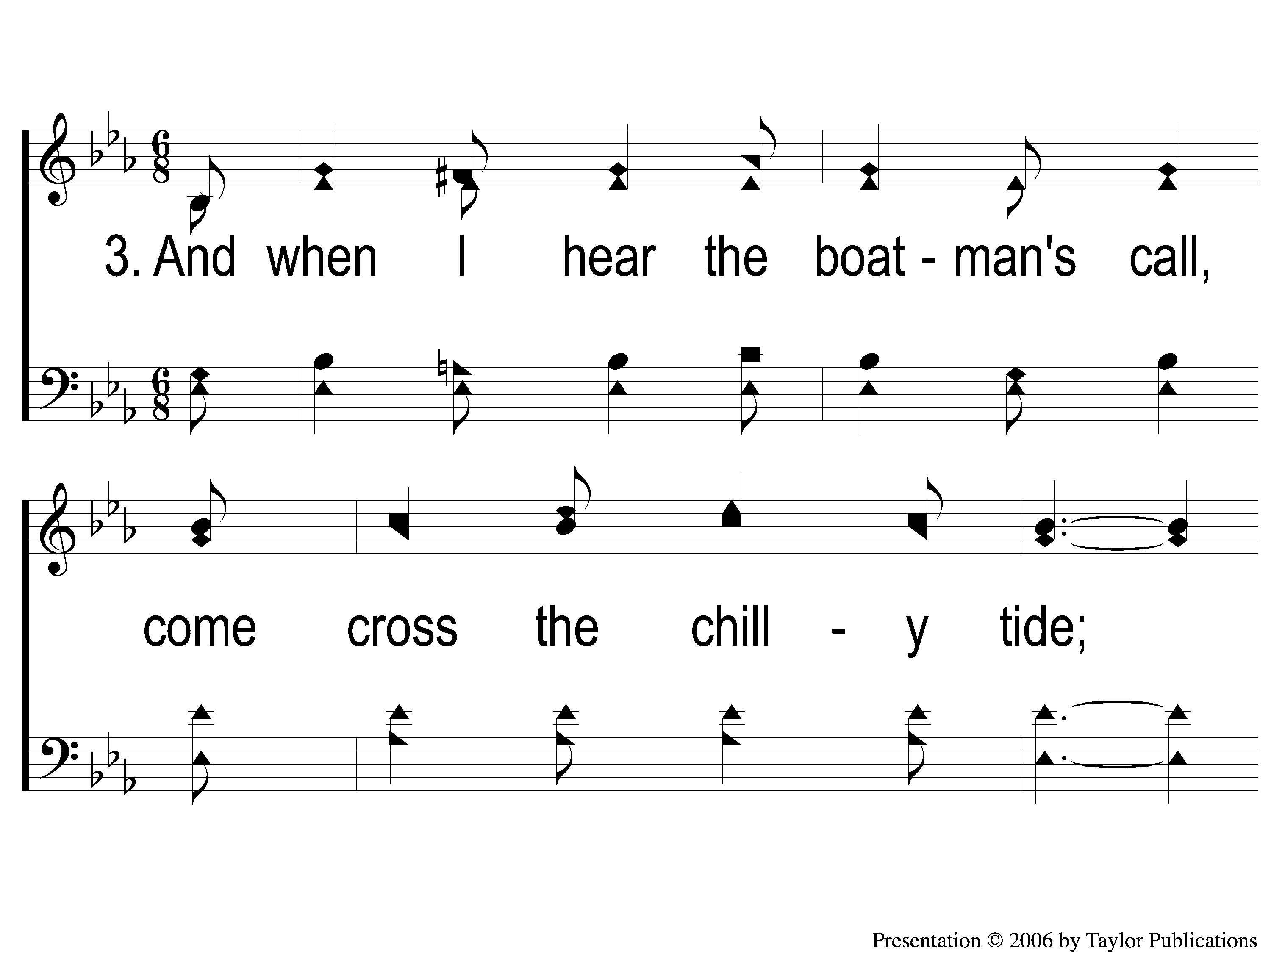
3-1 Christ’s Love Is All I Need
Christ’s Love Is All I Need
65

Slide 16
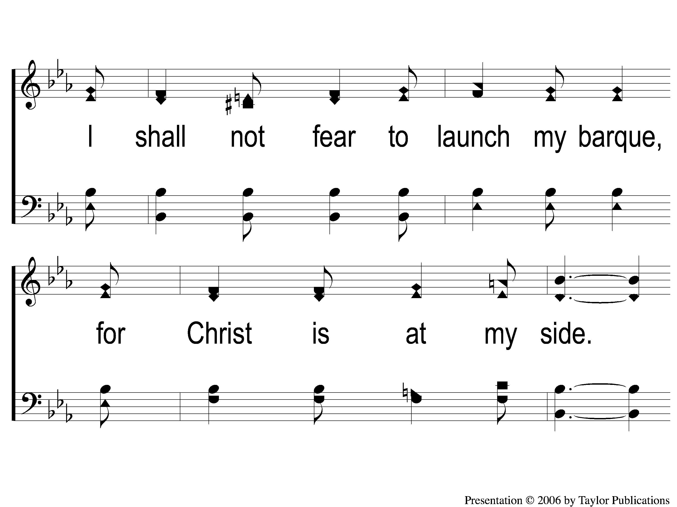
3-2 Christ’s Love Is All I Need
Christ’s Love Is All I Need
65

Slide 17
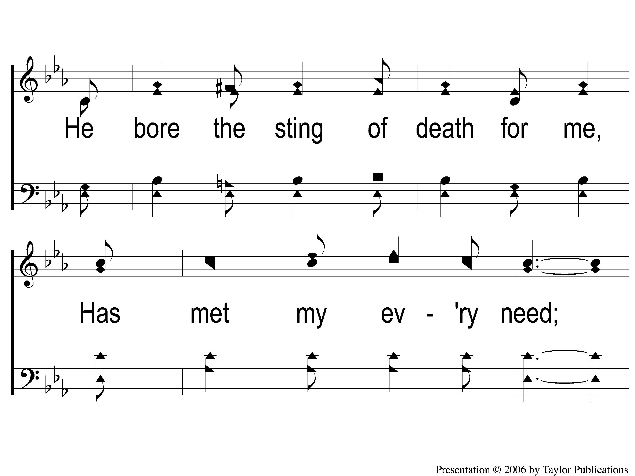
3-3 Christ’s Love Is All I Need
Christ’s Love Is All I Need
65

Slide 18
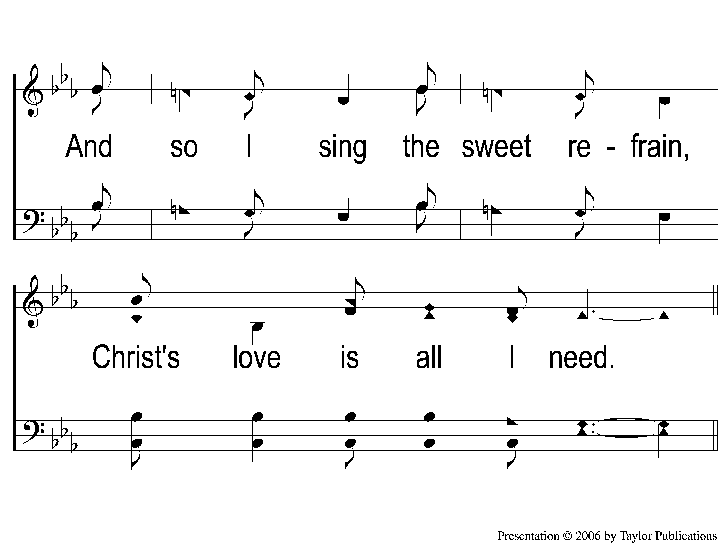
3-4 Christ’s Love Is All I Need
Christ’s Love Is All I Need
65

Slide 19
C-1 Christ’s Love Is All I Need
Christ’s Love Is All I Need
65

Slide 20
C-2 Christ’s Love Is All I Need
Christ’s Love Is All I Need
65

Slide 21
C-3 Christ’s Love Is All I Need
Christ’s Love Is All I Need
65

